Slide 1

Objectives
In this session, you will learn to:
  Process payroll in Tally.ERP 9

Slide 2
Processing Payroll in Tally.ERP 9
Payroll processing comprises of the following activities:
  Recording of attendance (on time or work)
  Processing payroll vouchers
  Payment of salaries

Slide 3
Processing Payroll in Tally.ERP 9 (Contd.)
Payroll vouchers are used:
  For the purposes of operating your payroll and records the attendance of the employees for a given period.
  For input information pertaining to payroll processing.
Tally.ERP 9 provides the following types of payroll vouchers:
  Attendance voucher
  Payroll voucher
  Payment voucher

Slide 4
Processing Payroll in Tally.ERP 9 (Contd.)
Attendance voucher:
  Is used to record employees’ attendance data, based on attendance or production types.
  Allows you to record the attendance or production units for employees.
Tally.ERP 9 gives you the flexibility to enter the attendance records through:
  A single attendance voucher for a payroll period.
  Multiple attendance vouchers as and when required within a payroll period.

Slide 5
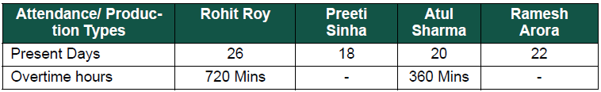
Demo: Creating Attendance Vouchers
Problem Statement:
  On 30th April, 2009 the attendance records of Indus Solutions Pvt. Ltd., displayed the details, as shown in the following figure.
  In the above scenario, separate attendance vouchers are required to be entered for recording Present days and Overtime hours.

Slide 6

Demo: Creating Attendance Vouchers (Contd.)
Let us see how to create Attendance Vouchers in Tally.ERP 9.

Slide 7
Processing Payroll in Tally.ERP 9 (Contd.)
Payroll voucher:
  Is used to record all employee-related transactions.
  Enables you to compute all the values for the respective Pay Heads (Earnings and Deductions).
The calculations are made on the basis of the definitions specified in the pay head masters, pay structure and attendance entries.

Slide 8
Processing Payroll in Tally.ERP 9 (Contd.)
In Tally.ERP 9, the disbursement of salaries can be effected in any of the following modes:
  Direct Remittance
  Bank Transfer

Slide 9

Demo: Creating Payroll Vouchers
Problem Statement:
  On 30th April, 2009, Indus Solutions Pvt. Ltd., processes Payroll for all the employees and entitled the following employees for Variable Pay.

Slide 10
Demo: Creating Payroll Vouchers (Contd.)
Let us see how to create Payroll Vouchers in Tally.ERP 9.

Slide 11
Processing Payroll in Tally.ERP 9 (Contd.)
Bank transfer:
  Refers to disbursement of salaries directly into the Employee Bank Accounts by intimating the Bank through payment advice.

Slide 12
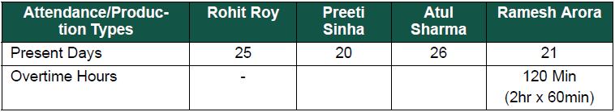

Demo: Creating Payroll Vouchers (Contd.)
Problem Statement:
  On 31st May, 2009 Indus Solutions Pvt. Ltd., disbursed Salaries payable for the month of May 2009 through Bank Transfer. The attendance records displayed the details, as shown in the following figure.
  On 31st May 2009, Indus Solutions Pvt. Ltd., processes Payroll for all the employees and entitled the following employees for Variable Pay.

Slide 13
Demo: Creating Payroll Vouchers (Contd.)
Let us see how to create Payroll Vouchers in Tally.ERP 9.

Slide 14
Payment of Salaries (Salary Disbursement)
In Tally.ERP 9, payment voucher can be used to effect salary disbursement to employees.
The payment voucher for the salaries payable may be passed through regular payment voucher or automated using the preset salary payment process available in Tally.ERP 9.

Slide 15
Demo: Making Salary Payments
Problem Statement:
  On 31st May 2009, Indus Solutions Pvt. Ltd., paid the salaries due for the month of May 2009.

Slide 16
Demo: Making Salary Payments (Contd.)
Let us see how to make salary payments in Tally.ERP 9.

Slide 17
Summary
In this session, you learned that:
  Attendance voucher is a voucher type used to record attendance, overtime, leave or production details.
  Payroll voucher is used to record employees’ payroll related transactions.

